Slide 1
BASIC COMPUTER USAGE
RAM
&
Hard Disk

Slide 2

OBJECTIVES FOR TODAY
What is RAM
RAM Type
What is Hard Disk?
Hard Disk Type?
How to use USB Flash Drive

Slide 3



EXPLORE
WHAT IS …?
5 MIN
Permanent
Temporary
Storage
Processing

Slide 4
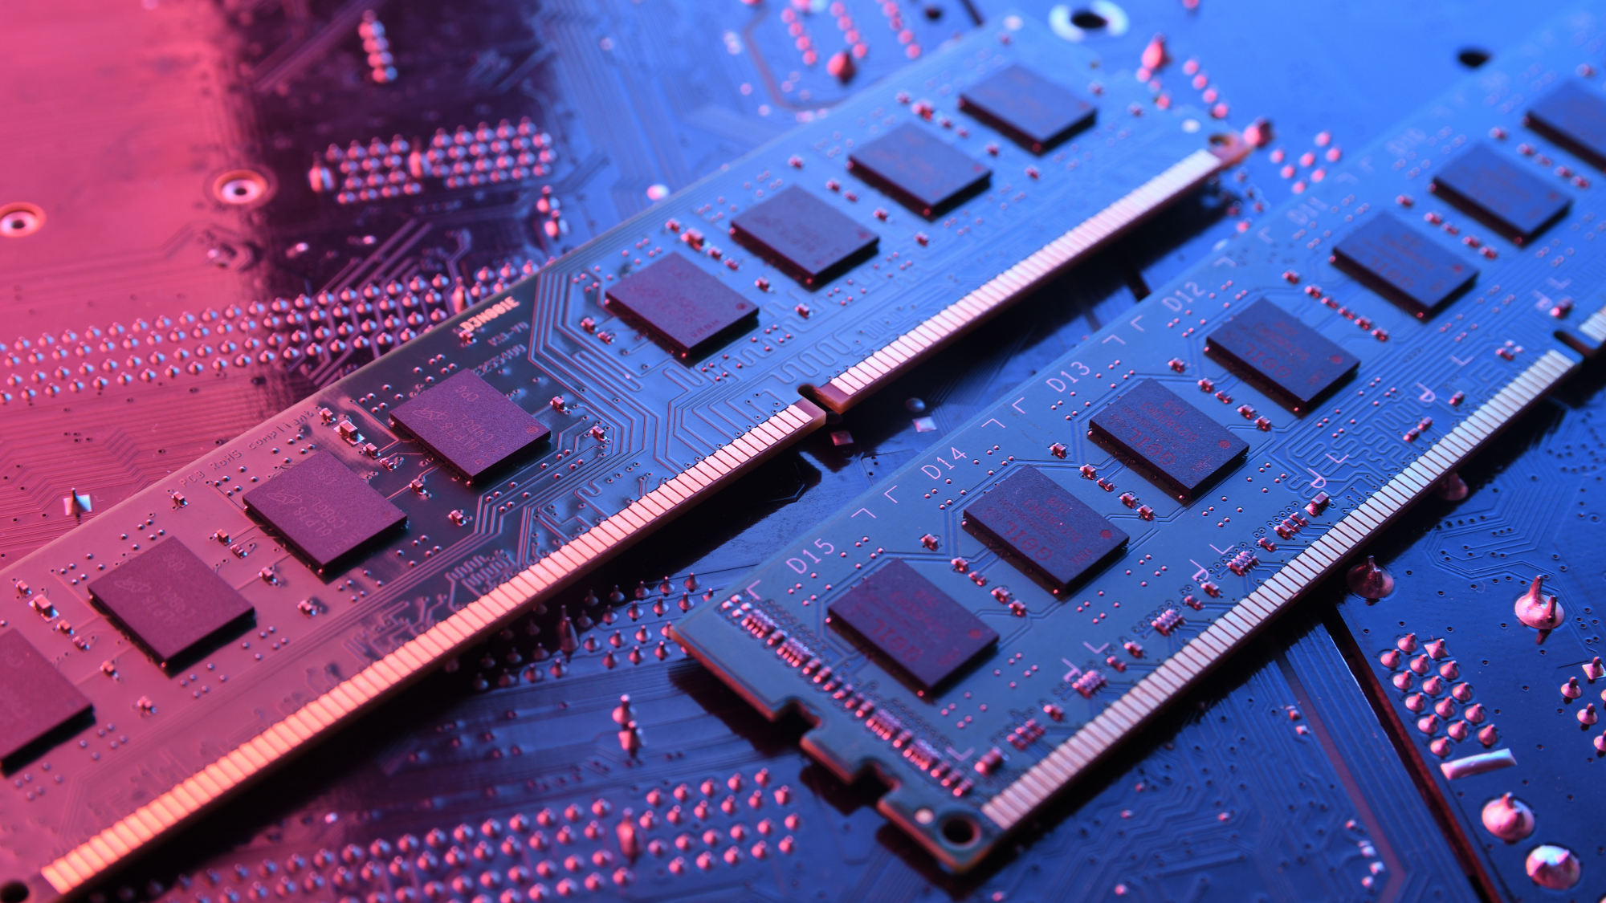
RAM (Random Access Memory)
Notes:
Primary storage device everything that are running are storing in RAM.
It speed of transfer data is faster than hard disk

Slide 5


RAM OVERVIEW
EXPLAIN
5 MIN
RAM (Random Access Memory),
is the “short-term memory” of the computer.
RAM capacity measured in GB.
RAM is a temporary storage device.
More RAM means more capacity to enhance system performance.
RAM
RAM is volatile memory, which means contents are erased when the computer is turned off.
Notes:
We can called RAM as Memory but is a bit :
Ram in Computer is a part of storage but it is a short term store.
But almost in Cambodia we call SD card as a memory.
And in phone we can call RAM and Memory is Memory, because Ram or Memory in Phone is storing OS and App recently used and other applications.
For file
Volatile memory means that It will delete automatically while we are turn off the PC.

Slide 6


What does RAM do for computer?
EXPLAIN
10 MIN
Helps boot up your computer
Responsible for holding data while the applications is running
Provide the quickly access to data that CPU need for processing
More RAM allow you to access multiple programs at a time
Click me!
Notes:
- Boot up means to start computer. Example: when we open the pc Os is running and store on RAM. So, cannot use Pc without RAM.

Slide 7
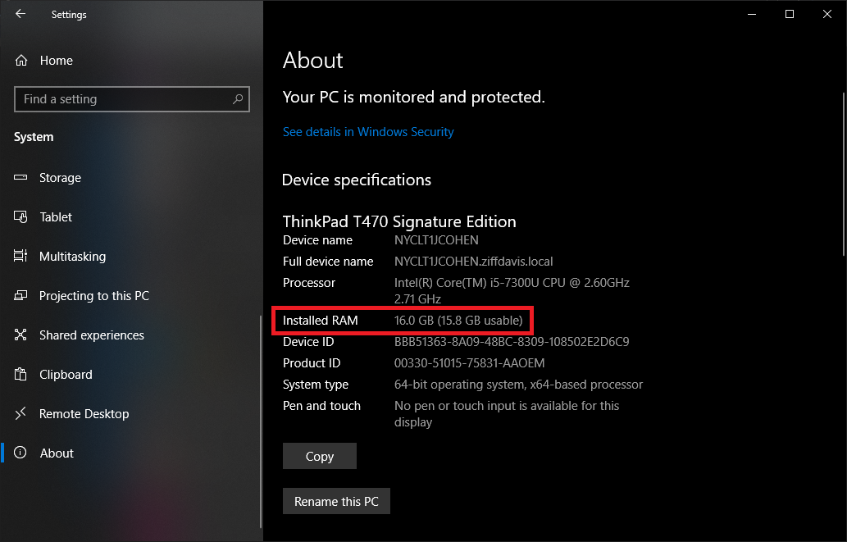
Finds out how much RAM you have
EXPLAIN
2 MIN
1
2
4
3

Slide 8
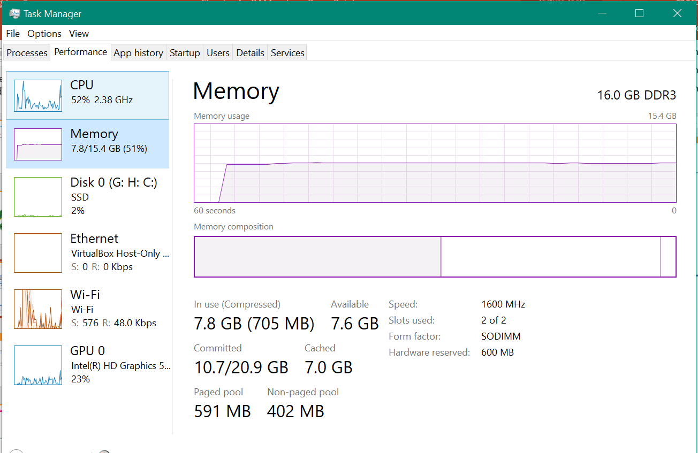
Finds out how much RAM you have
EXPLAIN
2 MIN
Task Manager
Right click on Taskbar > Select Task manager

Slide 9


WATCH & THINK
Watch the video to understand How RAM Work
5 MIN
Notes:
https://www.youtube.com/watch?v=2CJcotBkf6w

Slide 10
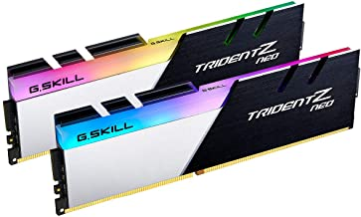
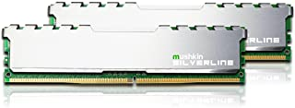
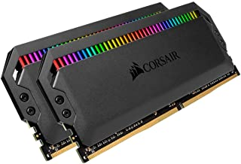
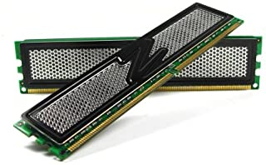
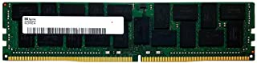
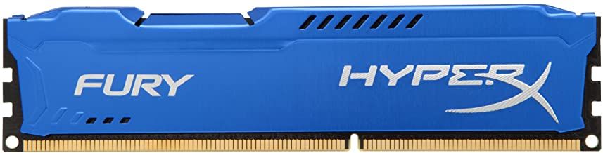
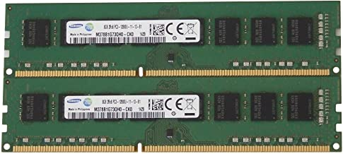
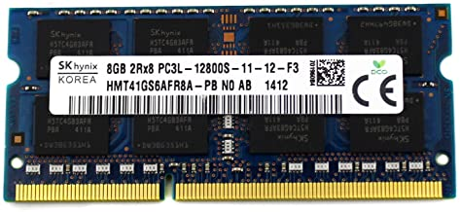
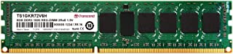
EXPLAIN
Top 10 Best RAM Manufacture
2 MIN
Corsair
G.Skill
Mushkin
Micron
Kingston
XTremeDDR
OCZ
Samsung
Transcend
Hynix

Slide 11
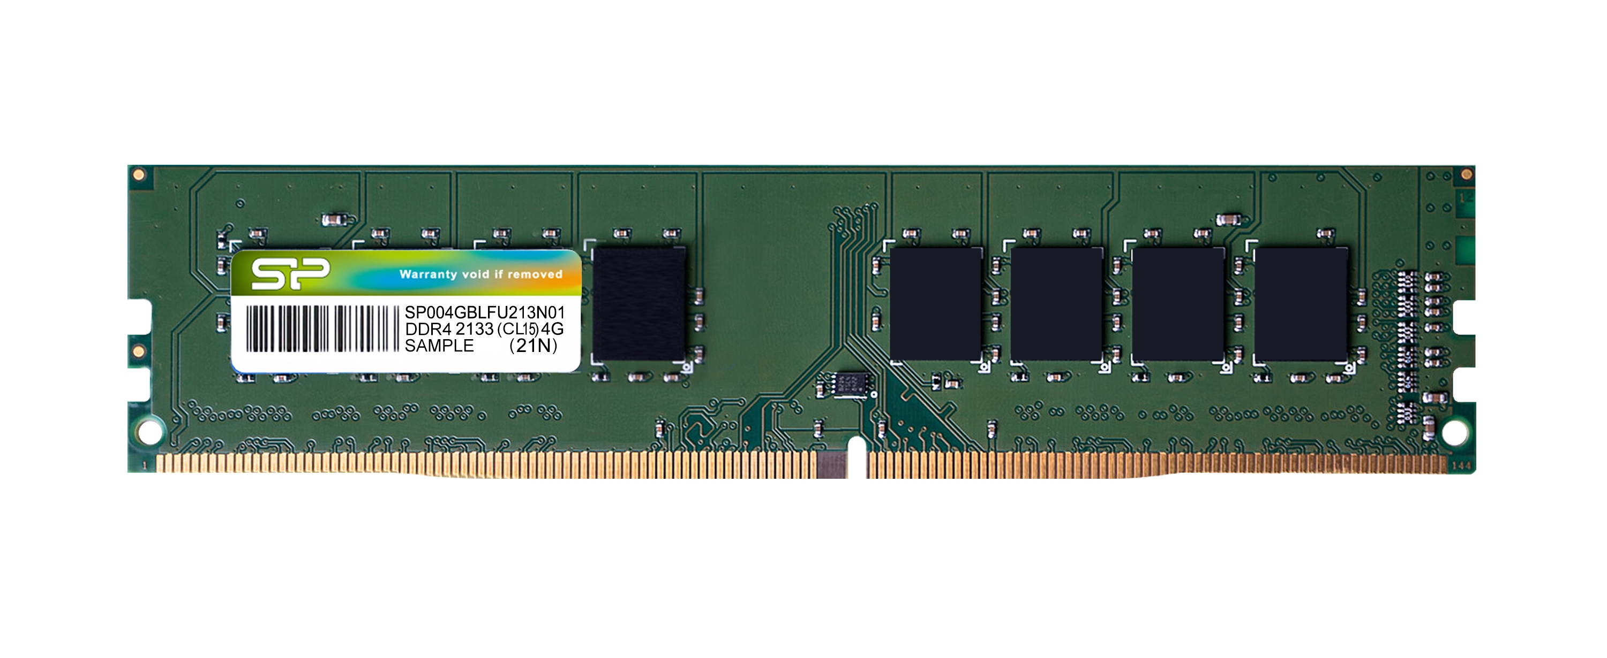
EXPLAIN
RAM Module consist of…
5 MIN
RAM CHIP
Board
PINS (Connectors)
Note: RAM Module is a board that holds RAM chips used for easy installation and removal from motherboard.
Notes:
Teacher can bring the broken motherboards (can ask from IT admin) to let student see what it look like.
All hardware of computer must be connected to a Mainboard.

Slide 12
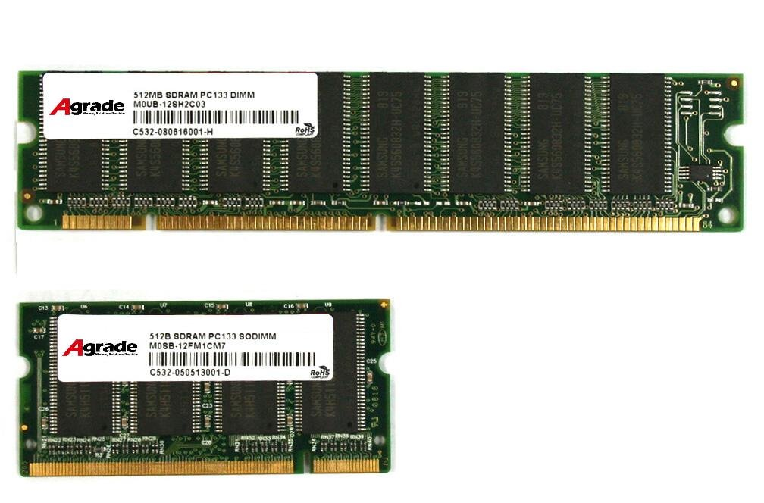
Type of RAM Modules
The common architecture of memory module:
Desktop use DIMM (Dual in-line memory module)
Laptop use SODIMM (Small Outline DIMMs)
DIMM
SODIMM

Slide 13
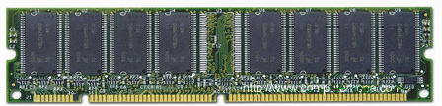
DIMM RAM Modules
Short for Dual In-line Memory Module (DIMM) is a module containing a circuit board and one more random access memory chips. DIMM holds DDR DDR2 DDR3 and DDR4 SDRAM.
DIMM module had 168-pins which can transfer 64 bits of data at a time and can support with 64-bits CPU type.
168-pins SDRAM DIMM
Notes:
DIMM :168-pin

Slide 14
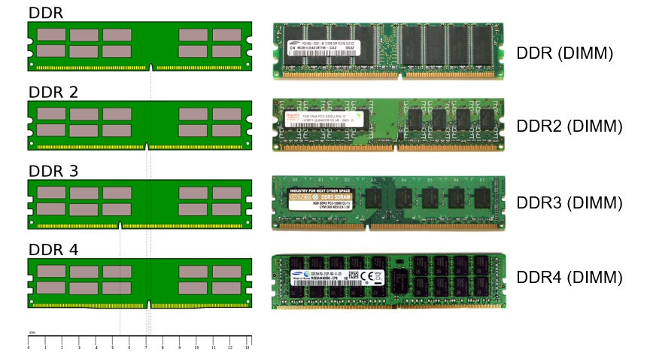
DIMM Memory Modules types
184-pins
240-pins
240-pins
288-pins

Slide 15
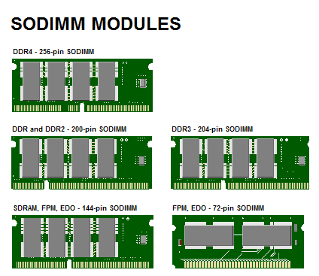
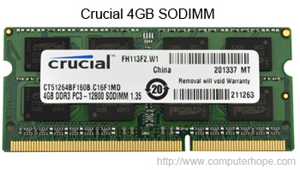
SO-DIMM Memory Modules
SO-DIMM, which is short for Small Outline DIMM. SO-DIMMs are commonly utilized in laptop computers. Below is an example picture of a 4GB SODIMM memory stick from Crucial.
Notes:
100 pin
144 pin
200 pin
204 pin
260 pin

Slide 16
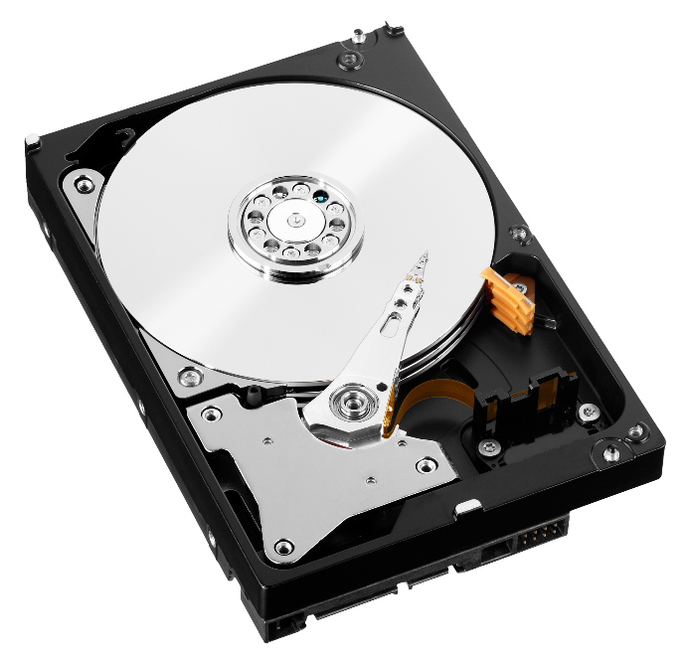
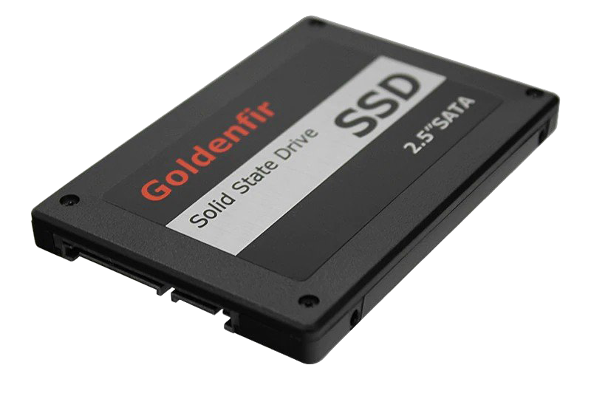
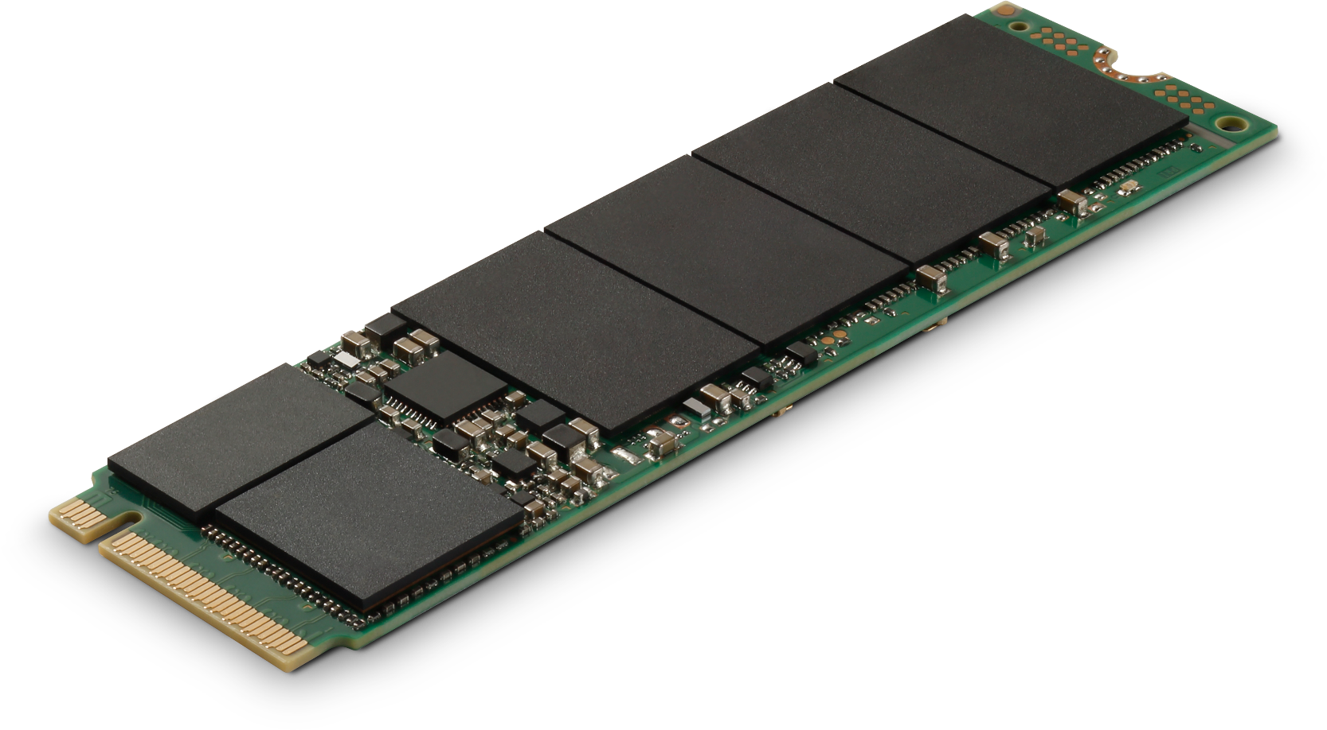
Hard Disk

Slide 17
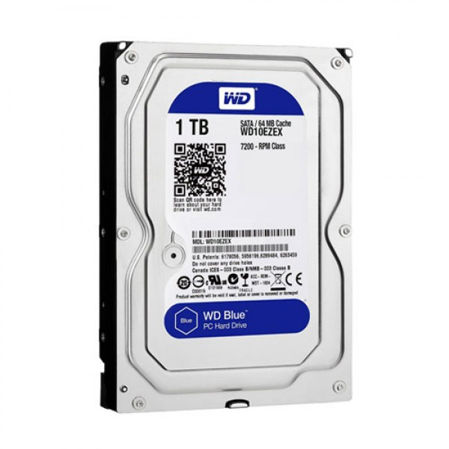
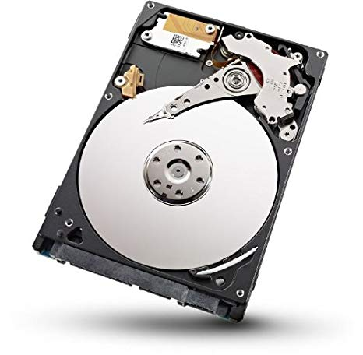

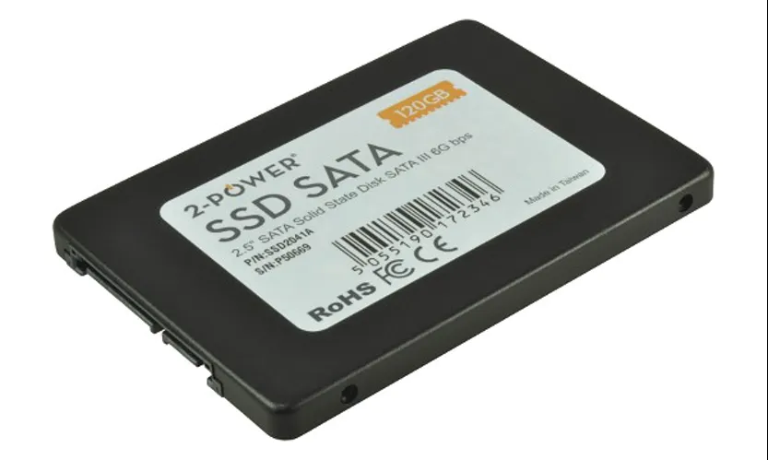
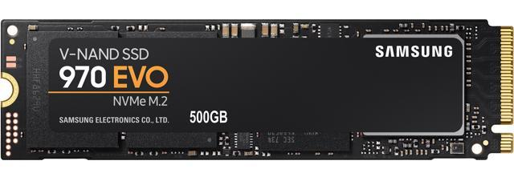
Type of Storage device in computer
There are two type of hard drive
Hard Disk Drive (HDD)
Solid State Drive (SSD)

Slide 18
EXPLAIN
OVERVIEW of STORAGE DEVICE
2 MIN
Storage device is a non-volatile memory hardware device that permanently stores and retrieves data on a computer.
The Operating system, software, and data files are stored in HDD/SSD.
HDD/SSD capacity measured in GB
HDD/SSD is a primary storage device in computer
Store information even after computer is turned off

Slide 19
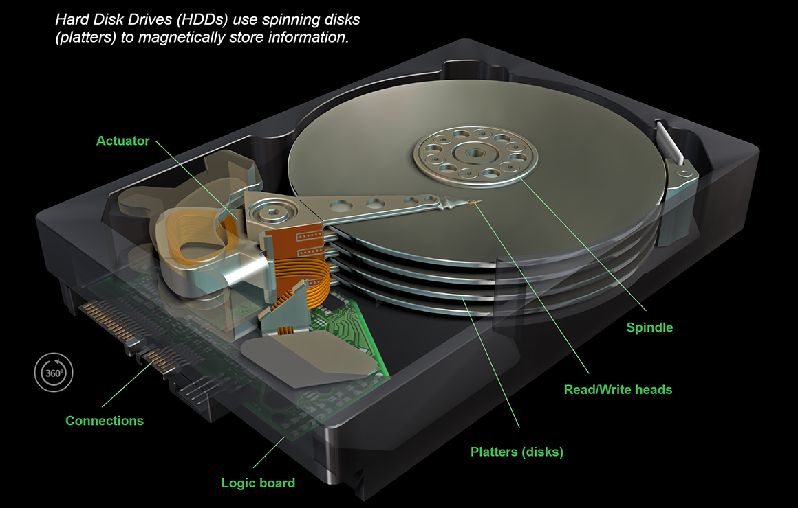
EXPLAIN
Hard Disk Drive (HDD)
5 MIN
Hard disk use magnetic heads on actuator arms controlled by a motor to read/write data from the platters. Two heads per platter. HDD write data on the platter in binary format 1 or 0.
Notes:
https://animagraffs.com/hard-disk-drive/

Slide 20
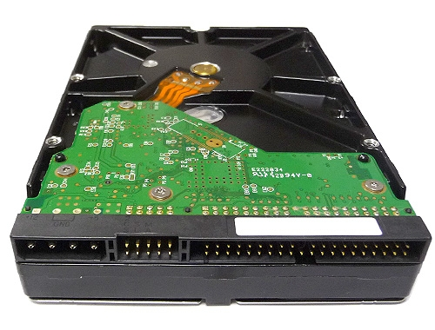
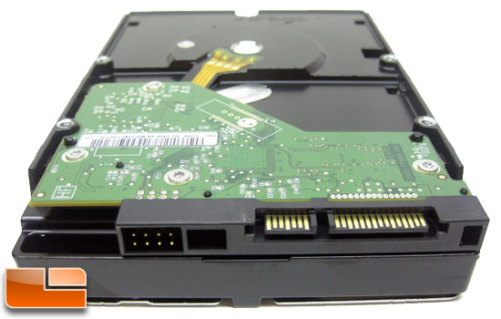
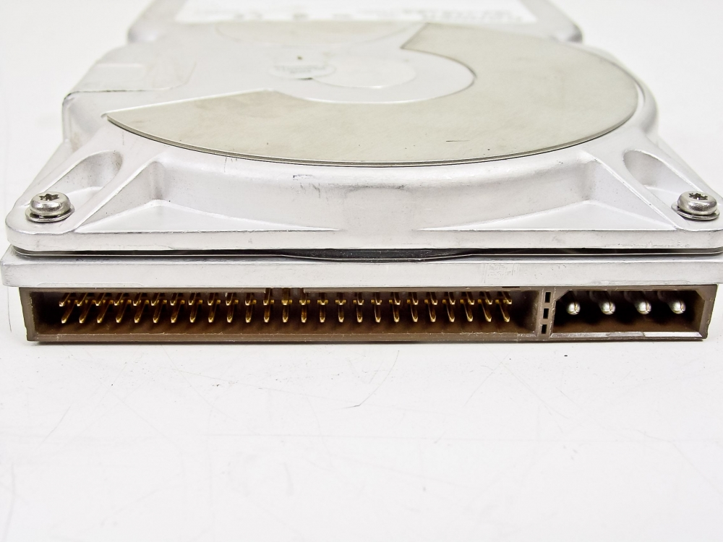
HDD Interfaces Connection
EXPLAIN
2 MIN
Common drive interfaces are:
Parallel ATA (PATA)
Integrated Drive Electronics (IDE)
Enhanced Integrated Drive Electronics (EIDE)
Serial ATA (SATA) and External SATA (eSATA)
Small Computer System Interface (SCSI)
Notes:
IDE – Integrated Drive Electronics, also called Advanced Technology Attachment (ATA) is an early drive controller interface that connects computers and hard disk drives.
EIDE – Enhanced Integrated Drive Electronics, also called ATA-2, is an updated version of the IDE drive controller interface.
PATA – Parallel ATA refers to the parallel version of the ATA drive controller interface.
SATA – Serial ATA refers to the serial version of the ATA drive controller interface.
eSATA – External Serial ATA provides a hot-swappable, external interface for SATA drives.
SCSI – Small Computer System Interface is a drive controller interface that can connect up to 15 drives. SCSI can connect both internal and external drives.

Slide 21
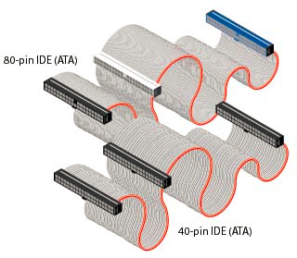
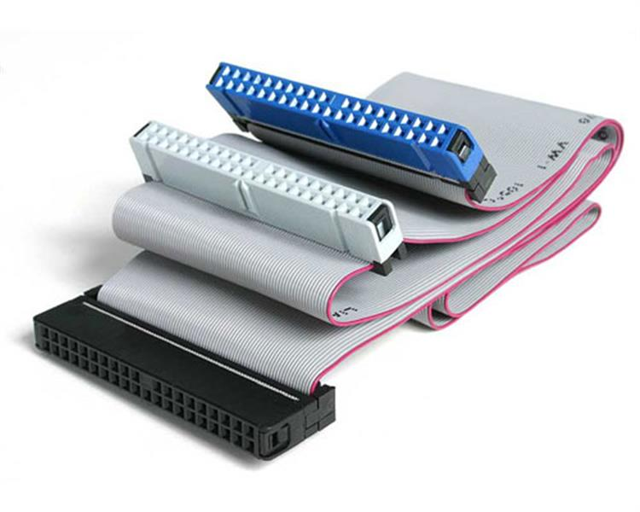
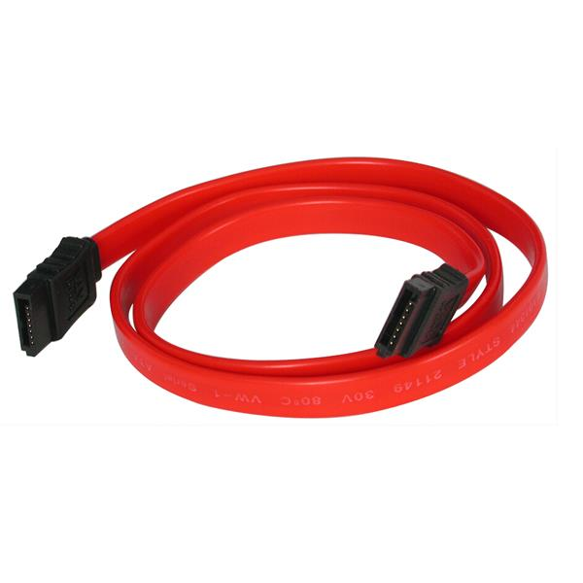
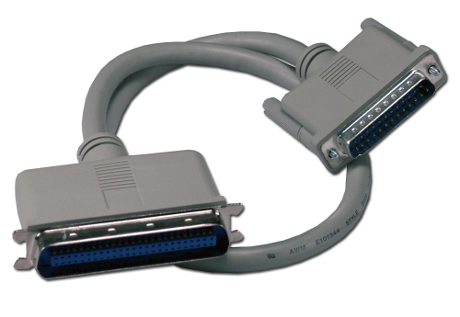
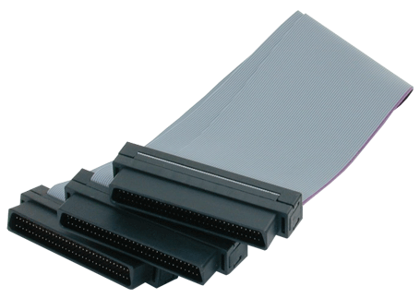
EXPLAIN
2 MIN
IDE/EIDE
HDD Cable Connector
SATA
SCSI
SCSI

Slide 22
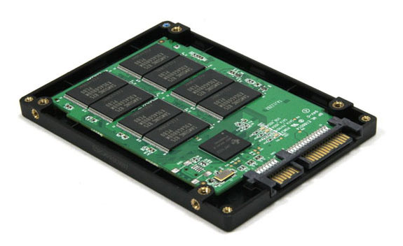
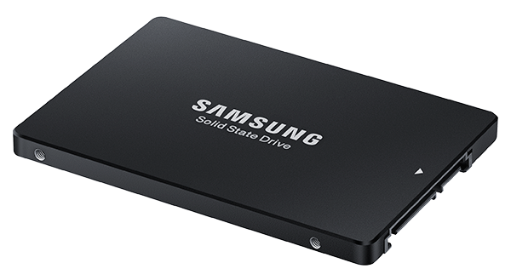
EXPLAIN
Solid State Drive
5 MIN
Short for Solid-State Drive or Solid-State Disk, SSD is a new generation of storage device used in a computers. SSD store data using NAND flash memory.
Unlike a hard drive, an SSD has no moving parts, which gives it advantages such as accessing stored information faster, no noise, often more reliable, and consuming less power.
Notes:
NAND flash memory is a type of non-volatile storage technology that does not require power to retain data. An important goal of NAND flash development has been to reduce the cost per bit and to increase maximum chip capacity so that flash memory can compete with magnetic storage devices, such as hard disks.

Slide 23
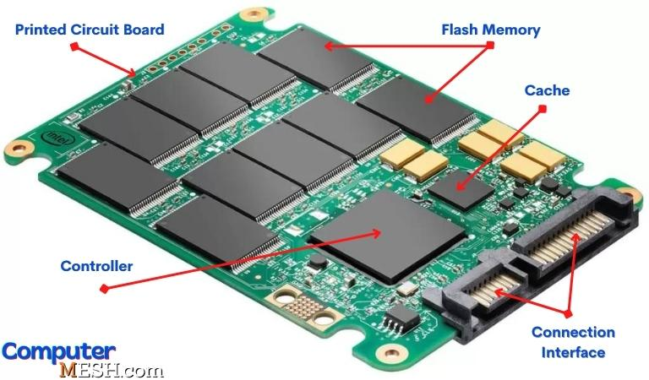
EXPLAIN
How SSD Work?
5 MIN
The Flash Memory is responsible for storing data (non-volatile memory NAND memory chip).
The Controller is responsible for how data gets stored in a flash memory.
The Cache is used to improves the performance of SSD.
The Connection interface is a physical connector for interact of SSD controller with the motherboard. (SATA, PCIe)

Slide 24
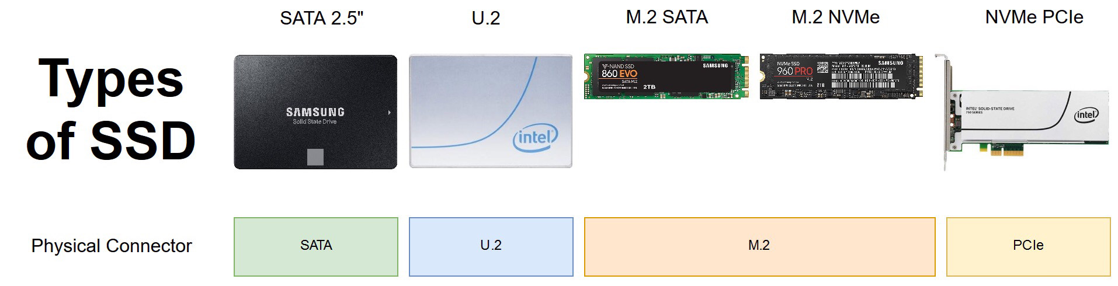
Different Type of SSD

Slide 25
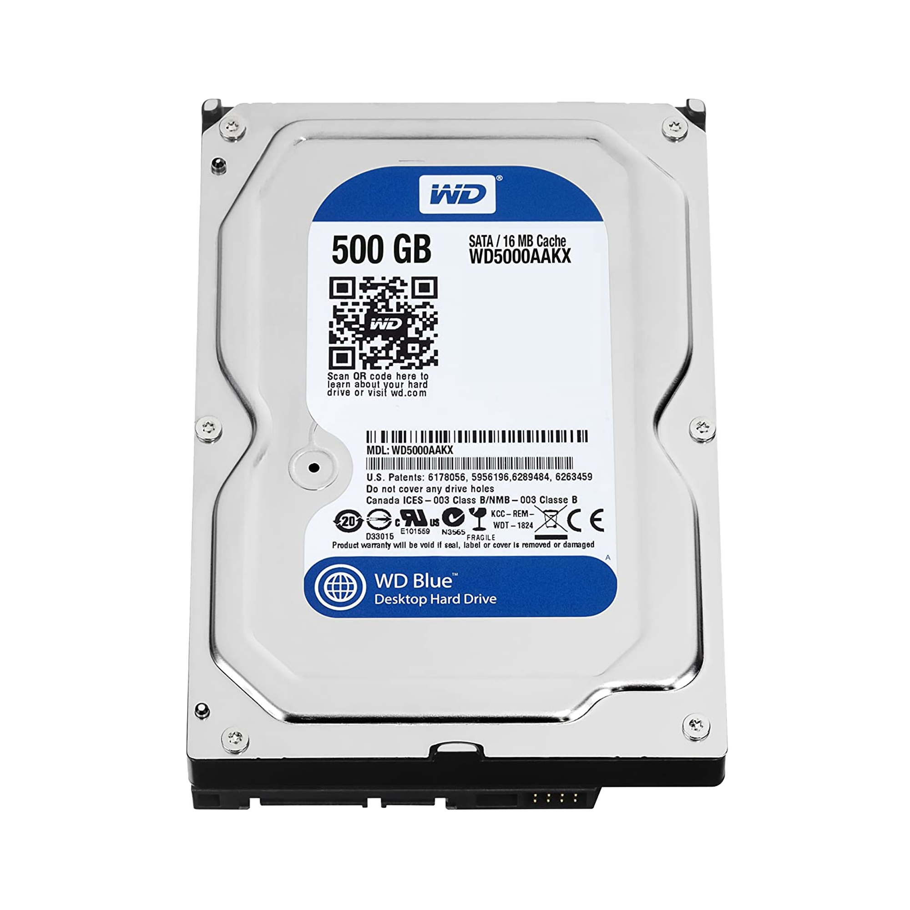
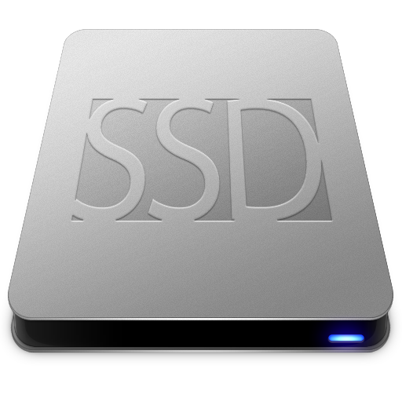
HDD vs SSD

Slide 26

Advantages of SSD over HDD
EXPLAIN
5 MIN
SSD has advantages over HDD:
Access time: speed to access data faster than HDD ( 2 or 3 times)
Reliability: has no moving parts, it use flash memory to store data.
Power: uses less power than a standard HDD
Noise: With no moving parts SSD generates no noise
Size: SSD is available in 2.5”, 1.8” and 1.0” – smaller and lightweight
Heat: generate less heat, helping to increase its lifespan
Notes:
Because a hard drive relies off magnetism to write information to the platter information could be erased from an HDD using strong magnets.

Slide 27

But, SSDs aren’t as popular as you might think?

Slide 28
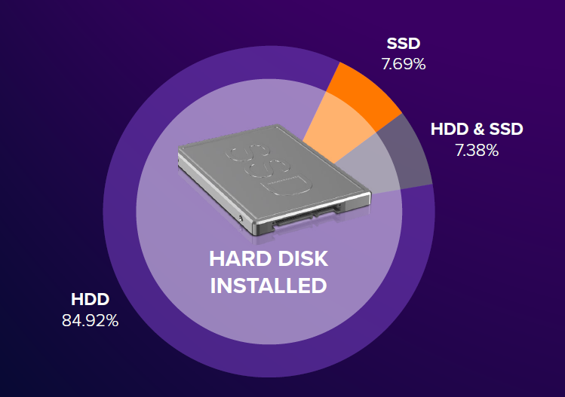
Percentage of people who use hard drive
Avast News, 29 January 2019

Slide 29
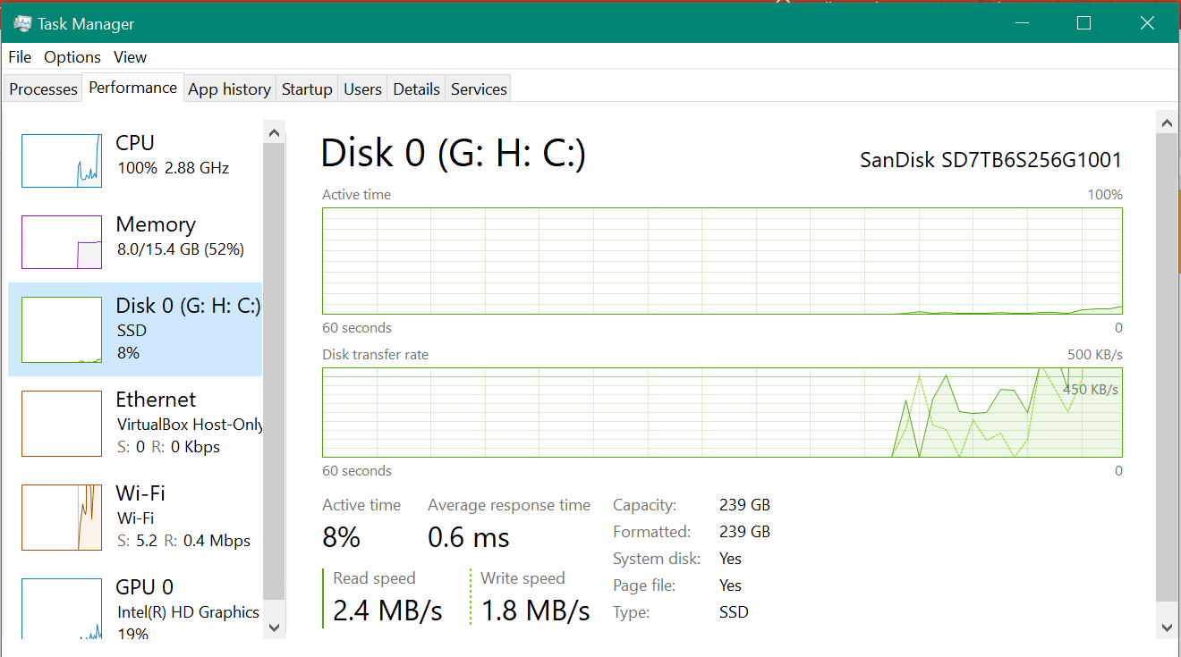
EXPLAIN
Finds out how much Storage Space you have
2 MIN
Task Manager

Slide 30
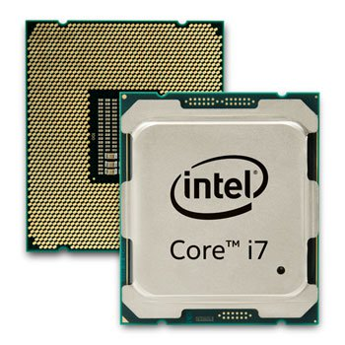
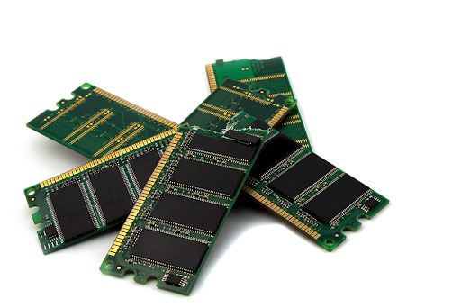
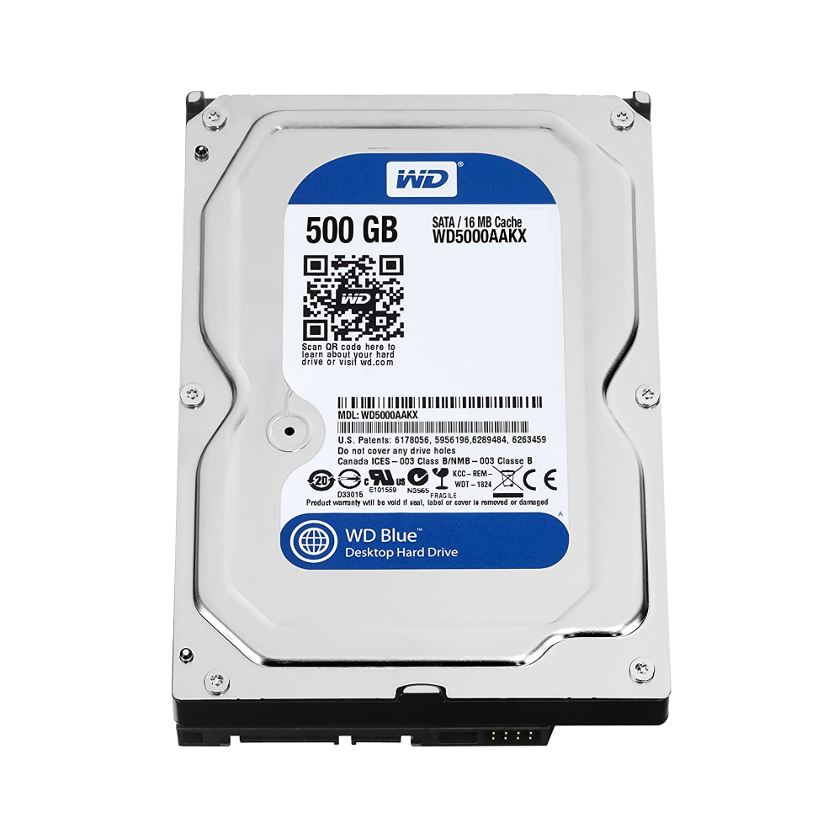

Relationship Between CPU, RAM, and HDD
Notes:
It does all decisions, calculations all processing in Computer.
Example. Even you typing or you move your mouse, all process need
CPU make decisions.

Slide 31
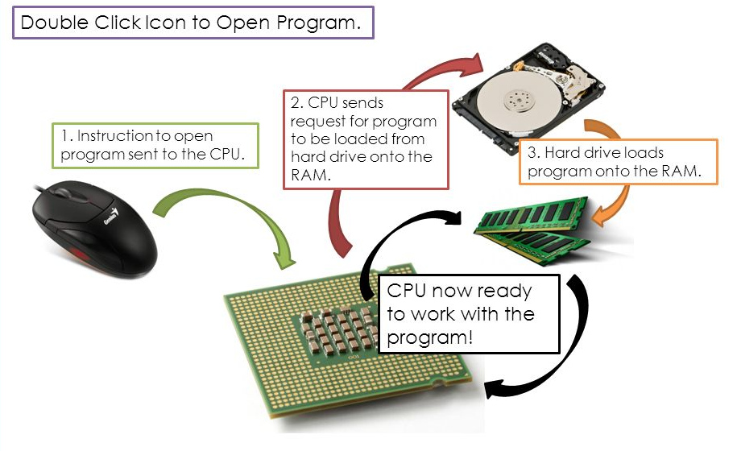
Relationship Between CPU and RAM
Notes:
How CPU Work?
How RAM work?
How them work together?
How computer work process?

